Slide 1
How to reconstruct mobile genetic elements using bioinformatics
Lee Katz, Ph.D.
Senior Bioinformatician, Enteric Diseases Laboratory Branch, Centers for Disease Control and Prevention, US
ESCMID Study Group on Epidemiological Markers
2022-07-07
The statements here do not necessarily reflect the opinions of CDC

Slide 2
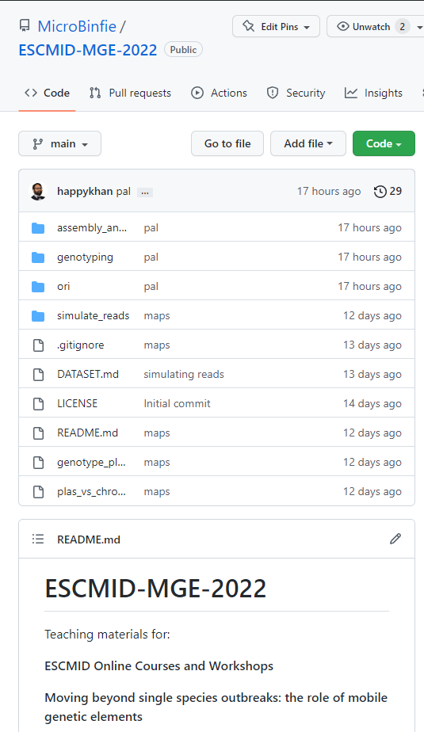


Quick outline
🔧 Bioinformatics tools
🔬 In depth analysis
🖼 Viz!
Let’s drink from a fire hose now
https://tinyurl.com/2022mge

Slide 3
What are MGEs
Covered in the morning session
But for our purposes:
Things in the genome that move around
Plasmids, IS elements, etc. AMR genes are commonly associated.

Slide 4
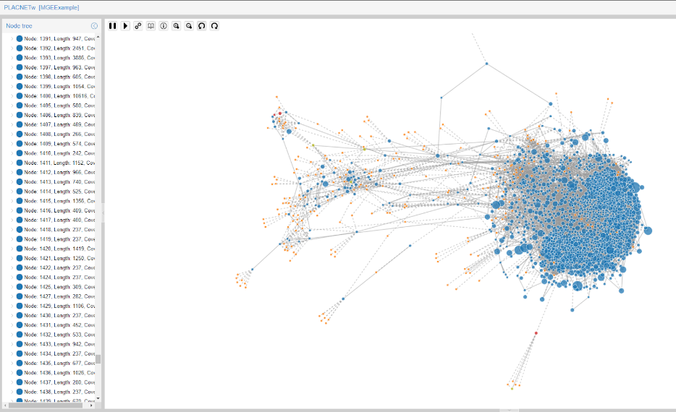
Plasmids
COPLA
Plasmidfinder
MOB-Suite
Abricate (plasmidfinder)
ARIBA (plasmidfinder)
PLACNET
PlasFlow
Notes:
Please reach out to the authors of these software especially since they are in the audience today and can talk more about them.

Slide 5
Plasmidfinder
assembly
BLAST
Matches
Runs blast on assemblies
Or, maps reads to db
Results
Name of plasmid match
Accession
etc
Reads
KMA mapping
Matches

Slide 6
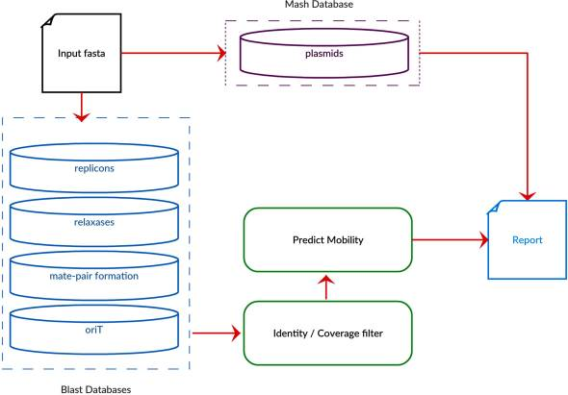
MOB-Suite
BLAST input vs dbs
Mash input vs dbs
Robertson J, Nash JHE. MOB-suite: software tools for clustering, reconstruction and typing of plasmids from draft assemblies. Microb Genom. 2018 Aug;4(8):e000206. doi: 10.1099/mgen.0.000206. Epub 2018 Jul 27. PMID: 30052170; PMCID: PMC6159552.

Slide 7
Abricate (plasmids)
assembly
BLAST
Matches
Blast vs several databases
NCBI AMRFinderPlus
CARD
Resfinder
etc
Table of results includes
Gene
Putative resistance
https://github.com/tseemann/abricate

Slide 8
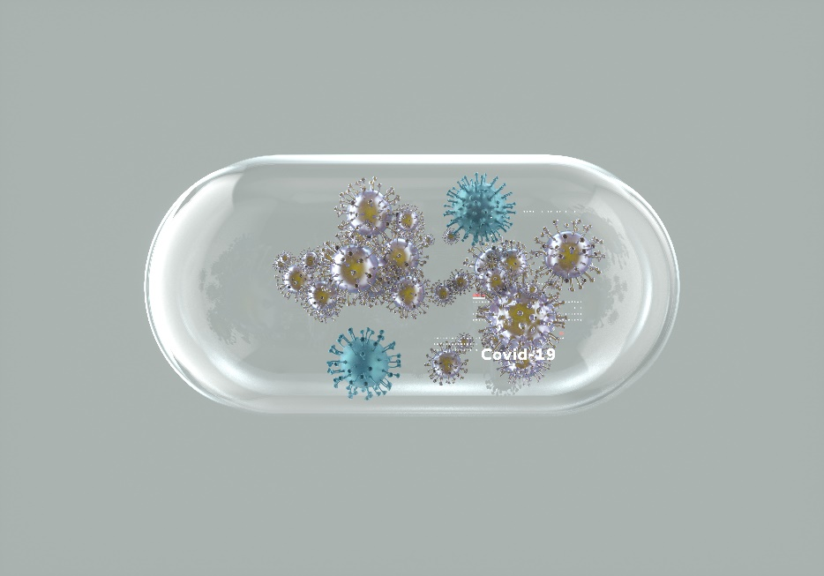
Antimicrobial resistance determining genes (AMR)
Resfinder
AMRFinderPlus
STARAMR
Abricate (plasmidfinder)
Abricate (resfinder)
Abricate (vfdb)
ARIBA (VFDB)

Slide 9
Resfinder
BLAST vs database
Database: manually curated by experts
Zankari E, Hasman H, Cosentino S, et al. Identification of acquired antimicrobial resistance genes. J Antimicrob Chemother. 2012;67(11):2640-2644. doi:10.1093/jac/dks261

Slide 10
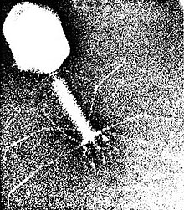
Other MGEs
Insertion sequence elements
ISEScan
ISFinder
Phages
PHAST/PHASTER
VirSorter 2
DeepVirFinder
Other types not mentioned here
https://commons.wikimedia.org/wiki/File:T4_phage_EM.jpg

Slide 11
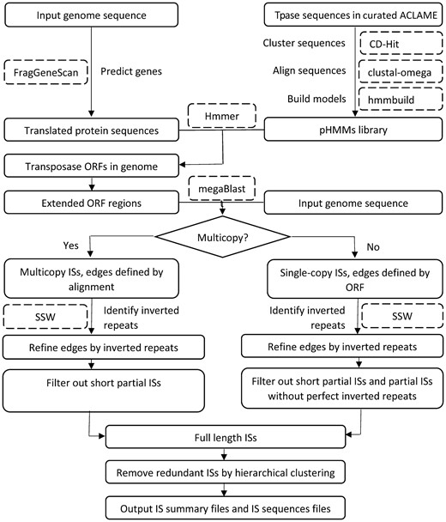
ISEScan
Predict genes
Search HMM models
megaBLAST
=> IS Elements
Zhiqun Xie, Haixu Tang, ISEScan: automated identification of insertion sequence elements in prokaryotic genomes, Bioinformatics, Volume 33, Issue 21, 01 November 2017, Pages 3340–3347, https://doi.org/10.1093/bioinformatics/btx433

Slide 12
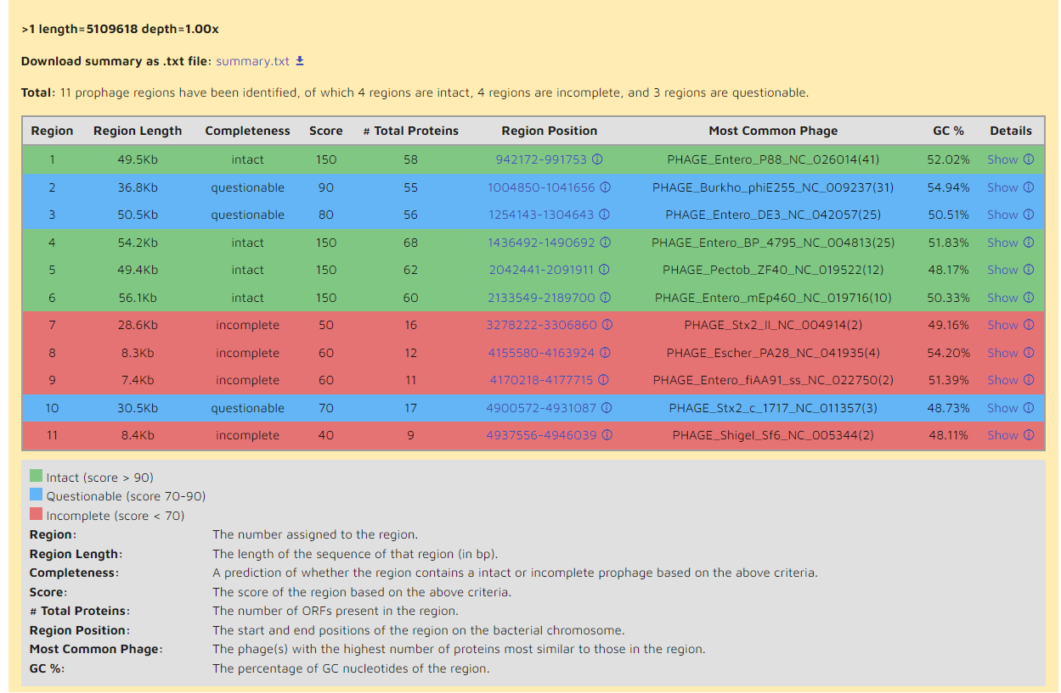
PHASTER
Annotation
Glimmer, tRNAscan-SE, ARAGORN
DBSCAN for finding clustered genes
Finding prophages
At least four viral genes
Cumulative length of the gaps between component clusters
Number and proportion of genes matching known prophage genes
Presence of blast hits that match a high proportion of a particular phage strain’s known genes
Presence of IS and viral genes with key functions including integrases transposases, and structural genes.
Arndt D, Marcu A, Liang Y, Wishart DS. PHAST, PHASTER and PHASTEST: Tools for finding prophage in bacterial genomes. Brief Bioinform. 2019;20(4):1560-1567. doi:10.1093/bib/bbx121

Slide 13
Example analysis

Slide 14
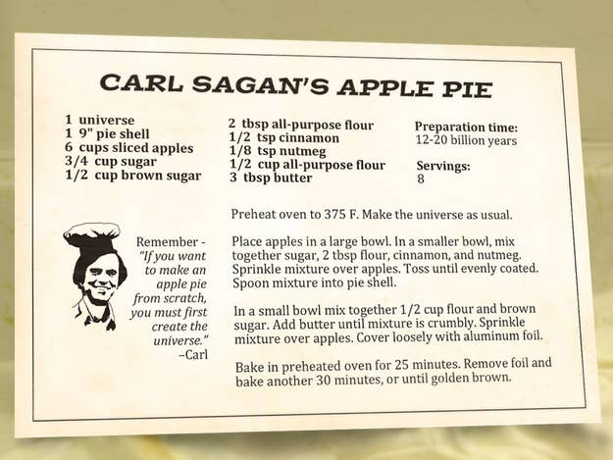
Prepare environment
Get the following software
Abricate
Resfinder
ISEScan
Notes:
https://en.wikipedia.org/wiki/Carl_Sagan

Slide 15
Let’s find and visualize the MGEs!
Generate results
Will put into viz software
Will need annotation files
Example file types
BED
GFF

Slide 16
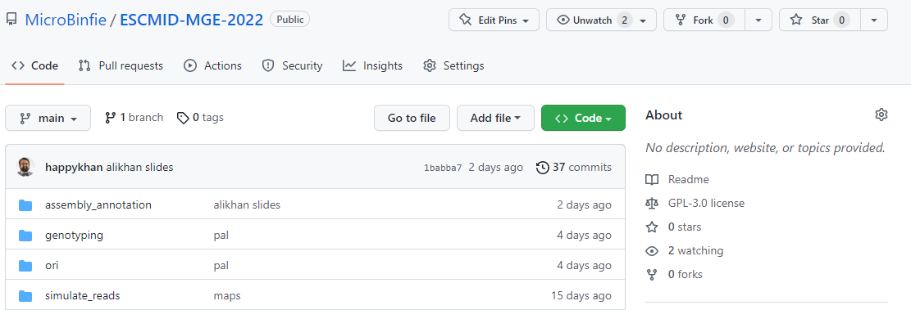
Grab some data
cd -pv ~/projects/ESCMID-2022
cd ~/projects/ESCMID-2022
git clone https://github.com/MicroBinfie/ESCMID-MGE-2022.git

Slide 17
Query with abricate
$ cd ESCMID-MGE-2022/ori
$ abricate EC958-HG941718.gbk > EC958-HG941718.gbk.abricate.tsv
$ cut -f 1,2,6,13,15 EC958-HG941718.gbk.abricate.tsv | column -ts $'\t’
# Make a BED file for later
$ cut -f 2-4,15 EC958-HG941718.gbk.abricate.tsv | tail -n +2 > abricate.bed
#FILE SEQUENCE GENE ACCESSION RESISTANCE
EC958-HG941718.gbk HG941718 blaEC-5 NG_049085.1 CEPHALOSPORIN
EC958-HG941718.gbk HG941718 blaCMY-23 NG_048818.1 CEPHALOSPORIN

Slide 18
Query with resfinder
$ any2fasta EC958-HG941718.gbk > EC958-HG941718.fasta
$ mkdir EC958-HG941718.gbk.resfinder
$ resfinder_db=/apps/x86_64/ResFinder/4.0/resfinder/resfinder_db
$ resfinder.py -i EC958-HG941718.fasta -o EC958-HG941718.gbk.resfinder -p $resfinder_db --extented_output
-i input fasta
-o output folder
-p databases folder
--extented_output
=> creates GFF file

Slide 19
Query with resfinder
$ cut -f 1,2,7,8 EC958-HG941718.gbk.resfinder/results_tab.tsv | \ column -ts $'\t’
# Make a BED file for later
$ cat EC958-HG941718.gbk.resfinder/results_tab.tsv | tail -n +2 | \
perl -F'\t' -lane ‘
($start,$stop)=split(/\.{2}/, $F[5]);
print join("\t",$F[4], $start, $stop, $F[6]);
' > resfinder.bed
🐪
Database Resistance gene Predicted phenotype Accession number
beta-lactam blaCMY-23 Beta-lactam resistance DQ438952
macrolide mdf(A) Warning: gene is missing from Notes file. Y08743

Slide 20
Query with ISEScan
$ isescan.py --seqfile EC958-HG941718.fasta --output EC958-HG941718.isescan --nthread 8
$ ls EC958-HG941718.isescan
EC958-HG941718.fasta.csv EC958-HG941718.fasta.orf.faa EC958-HG941718.fasta.raw hmm
EC958-HG941718.fasta.gff EC958-HG941718.fasta.orf.fna EC958-HG941718.fasta.sum proteome
EC958-HG941718.fasta.is.fna EC958-HG941718.fasta.out EC958-HG941718.fasta.tsv
--seqfile fasta input
--output is a folder
--nthread number of threads
Zhiqun Xie, Haixu Tang, ISEScan: automated identification of insertion sequence elements in prokaryotic genomes, Bioinformatics, Volume 33, Issue 21, 01 November 2017, Pages 3340–3347, https://doi.org/10.1093/bioinformatics/btx433

Slide 21
Count different kinds of IS elements
$ grep -o -E 'family=[^;\s]+' EC958-HG941718.isescan/EC958-HG941718.fasta.gff | \ sort | uniq -c
5 family=IS1
3 family=IS110
1 family=IS1380
4 family=IS200/IS605
12 family=IS21
15 family=IS3
2 family=IS30
2 family=IS4
1 family=IS481
1 family=IS5
16 family=IS66
1 family=ISAS1
3 family=ISL3
7 family=ISNCY
1 family=new

Slide 22
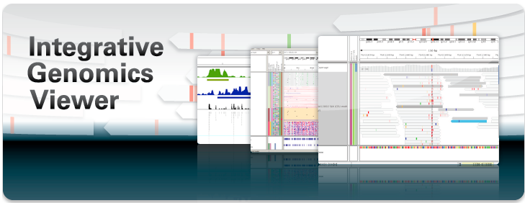
Visualize with Integrative Genomics Viewer (IGV)
James T. Robinson, Helga Thorvaldsdóttir, Wendy Winckler, Mitchell Guttman, Eric S. Lander, Gad Getz, Jill P. Mesirov. Integrative Genomics Viewer. Nature Biotechnology 29, 24–26 (2011).
https://software.broadinstitute.org/software/igv/

Slide 23
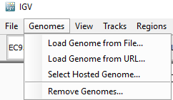
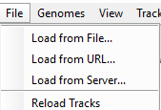
Visualize your genome with features
Step 1: load genome from File
Step 2: Load from File

Slide 24
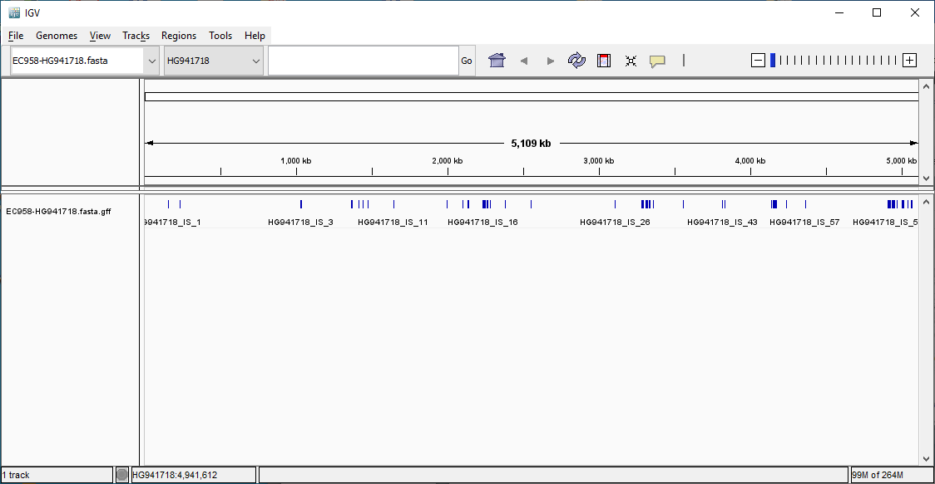
The genome has been loaded
…Let’s load more tracks

Slide 25
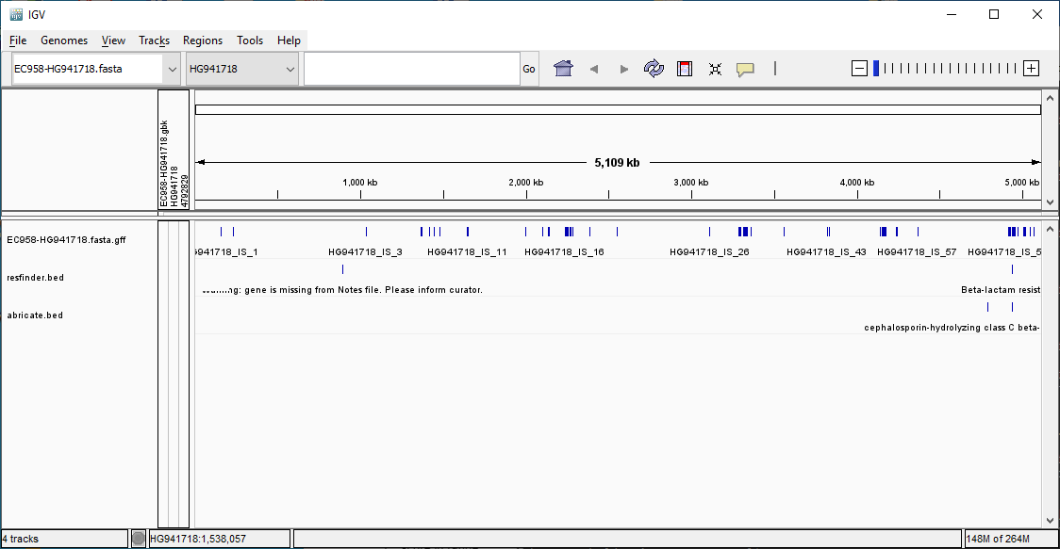
More tracks

Slide 26
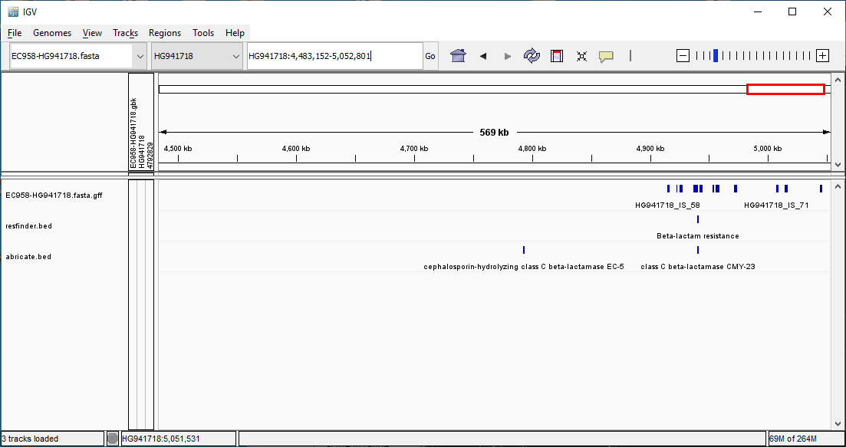
Zoomed in

Slide 27
Done!
There are several annotators out there
We learned a few
Then we learned how to show it to the team
The statements here do not necessarily reflect the opinions of CDC

Slide 28
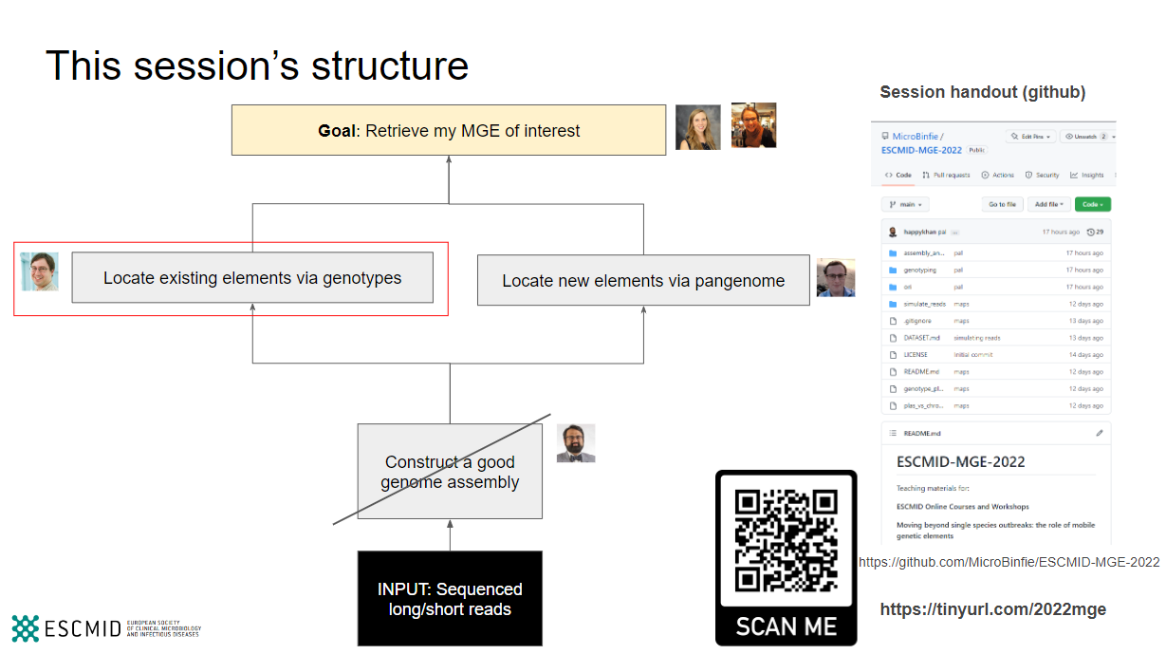





This session’s structure
Lee Katz
gzu2@cdc.gov
lskatz
github.com/lskatz
microbinfie.github.io

